Slide 1
Part II – Databrick by brick
An introduction to MLOPS in databricks, by means of a simple automated pipeline

Slide 2
So far:
We have looked at Optuna for exploring the parameter space for models.
We discussed MLflow as a method of managing training and artifact storage.

Slide 3
Now:
We look at hosting a small automated toy pipeline for training, evaluating and deploying a model on databricks.

Slide 4

Instructions:
If you want to take the opportunity to explore databricks and connect our pipeline from the provided components (recommended), feel free to use the QR code, link or search for “databricks free edition” to set up a free account and follow along.
https://www.databricks.com/learn/free-edition

Slide 5
Databricks (introduction)
Data warehouses offered a structured/rigid way of storing data allowing for simple data lineage tracing and various forms of governance.
With the growing volume and variety of data, the idea of datalakes became popular with cheap and efficient scaling.
“How does one govern a country with 246 varieties of cheese.”
Data lakehouses such as what databricks facilitates attempts to offer a best of both worlds allowing for large quantities of varied and distributed yet manageable data.

Slide 6
Databricks (introduction)
Databricks is intrinsically cloud based, so to run notebooks/scripts, you need to designate your computational resource for the run.
You may also select environments and define additional requirements.
This tutorial is based on the ML environment (v5) which already contains optuna, mlflow and pytorch.

Slide 7
Navigation
Workspace
Gitfolders
Catalogue
Experiments
Models
Serving
Jobs

Slide 8
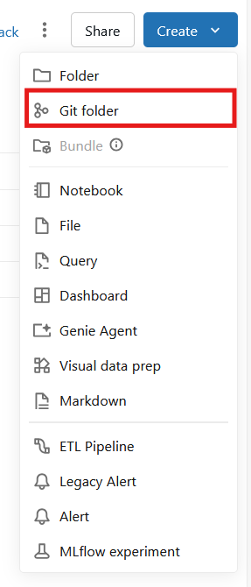
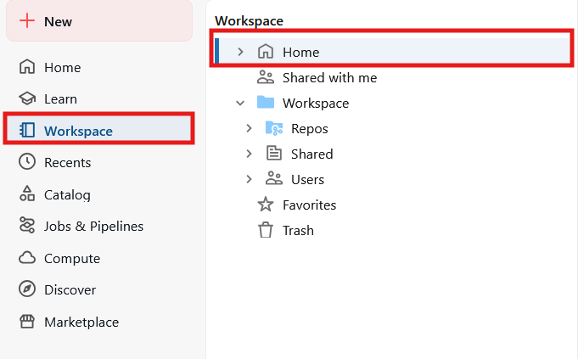
Adding our project
Once you have logged in with databricks, we can explore our workspace.
In Home, go to create and select “git folder”.

Slide 9

Material
https://github.com/caisr-hh/handson_mlflow_optuna

Slide 10
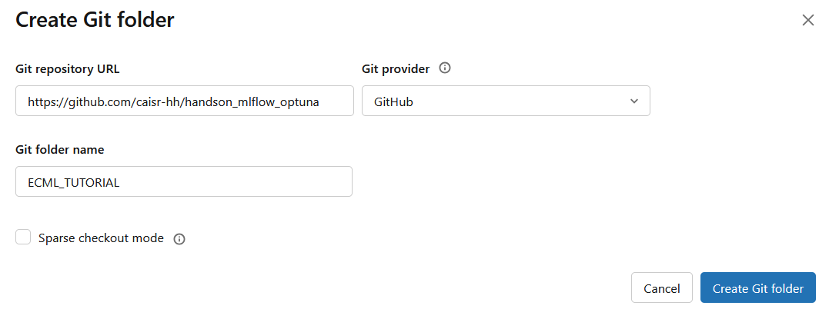
Adding our project
Provide the link and provider for our repository.
(same as for part 1).

Slide 11
Data in databricks
Data stored in databricks unity catalogue follows the format:
Catalogue.schema.table
(This is true as well for other things such as models)
If we run the “setup_catalog” notebook once, we can then run the datagen notebook to generate the data to the table: ecml.data.tutorial_data

Slide 12
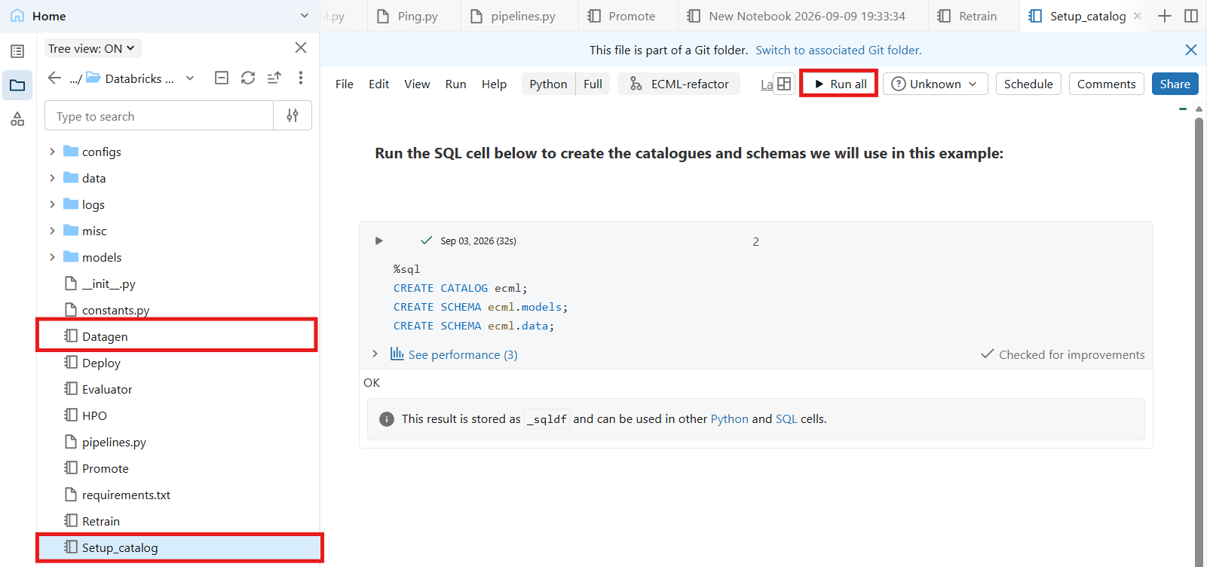
Data in databricks

Slide 13
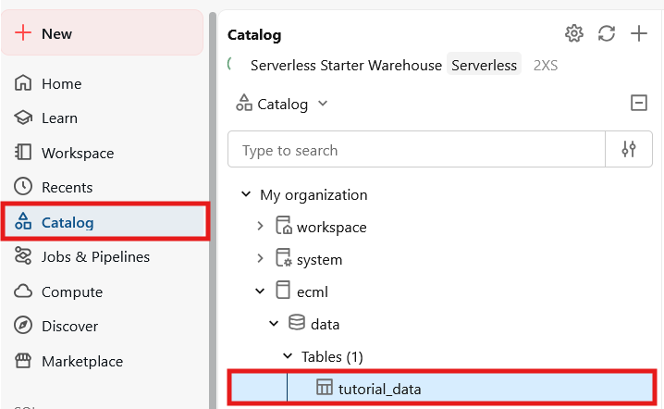
Data in databricks

Slide 14
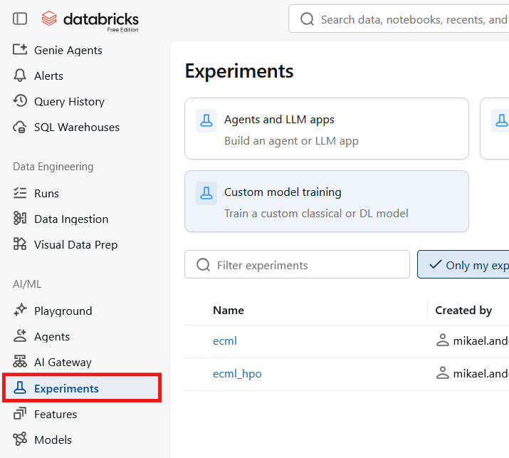
Experiments
Not much changes from the MLflow we have used so far, except that databricks hosts its own servers, and automatically sets the tracking to direct there by default.
New experiments are created for each notebook that calls MLflow, unless we specify our own experiments.

Slide 15
Models and registered models
Separate model artifacts
Registered models are accessible by name and alias
(note that this can cause “orphaned” runs)

Slide 16
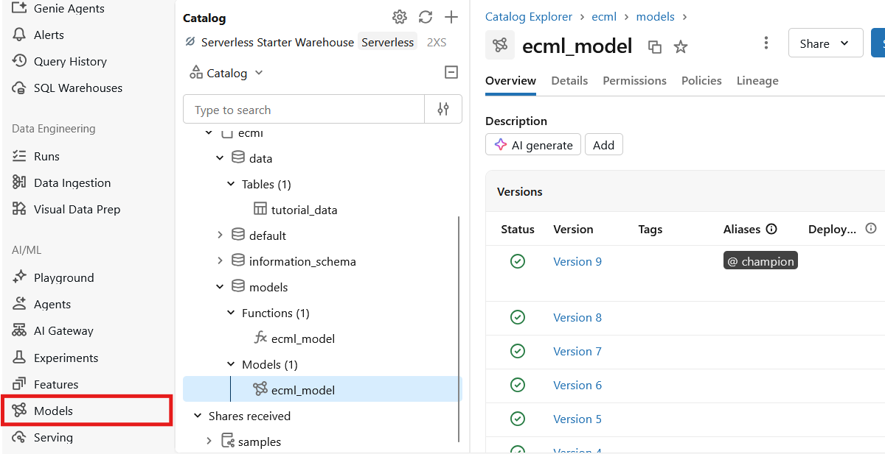
Models and registered models

Slide 17
Serving
Databricks also allows you to easily serve endpoints.
I recommend testing hosting a serverless endpoint in the free edition to test communicating with the endpoint (first call will have a significantly longer latency).

Slide 18
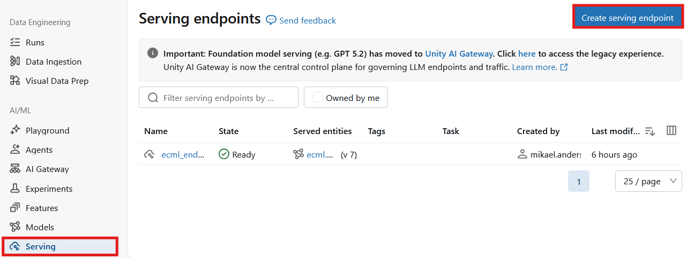
Serving

Slide 19
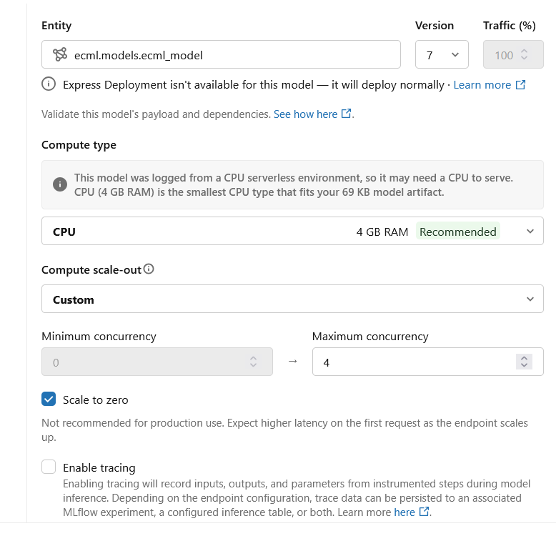
Serving

Slide 20
Jobs
Tasks.
Notebook oriented.
Easy to schedule and set up dependencies.
Can communicate variables through dbutils.
For example:
dbutils.jobs.taskValues.set("result", result)

Slide 21
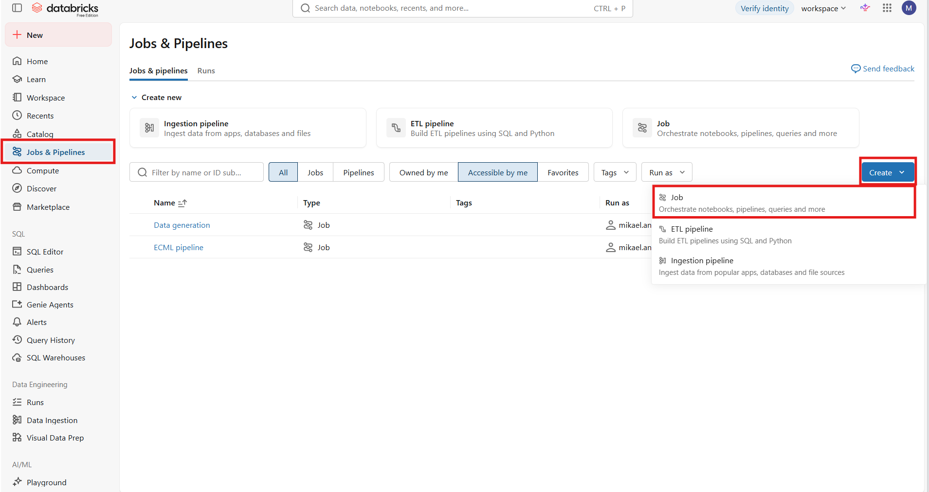

Slide 22
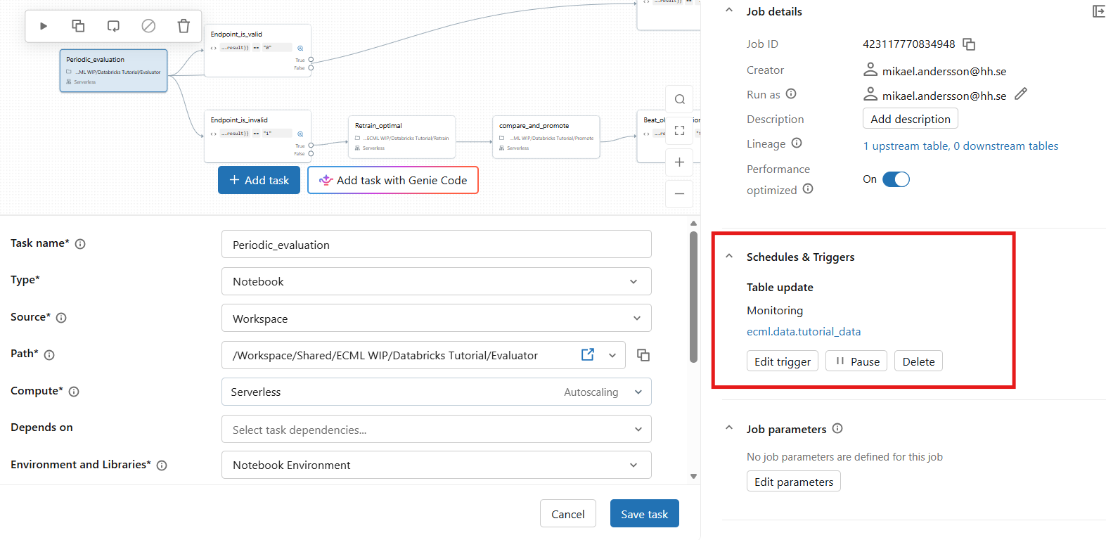
Scheduling:

Slide 23
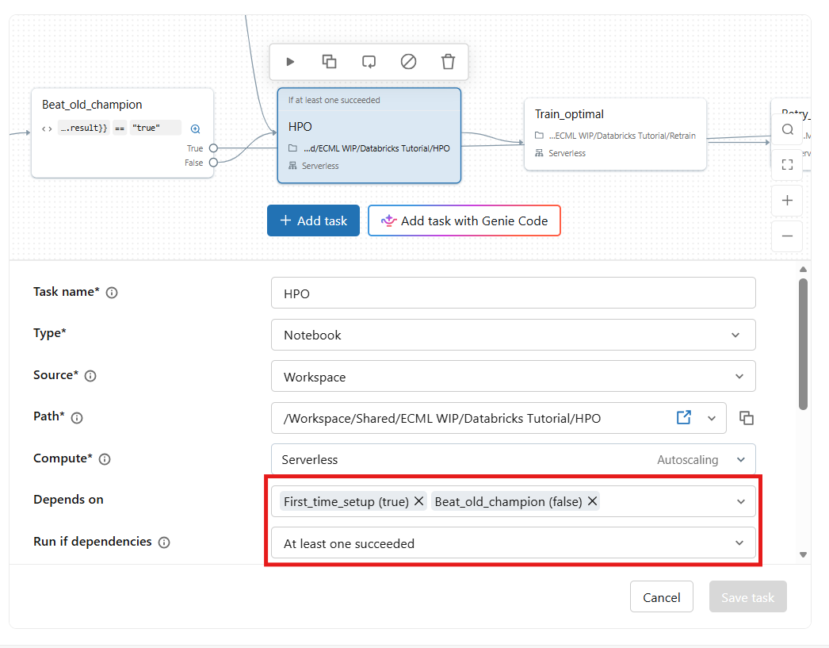
Dependencies:
Use dependencies to set up conditional flows.
You may use task variables and if/else nodes to serve as dependencies for this purpose.

Slide 24
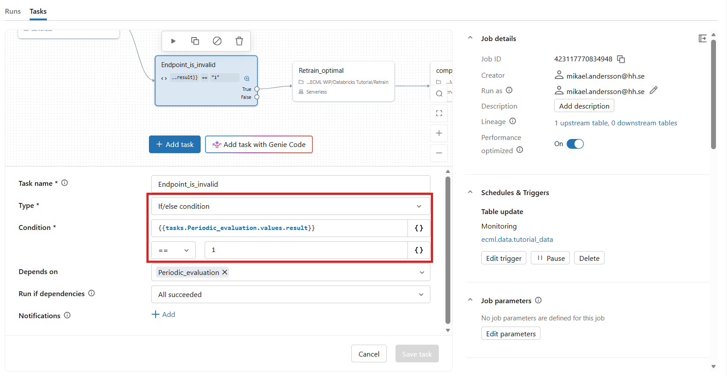
Task variables and control flows:

Slide 25
A simple automated pipeline:
Model degrading
Retrainer
Promotion
Promoted
Deploy
Evaluator
Not promoted
HPO
Retrainer
Promotion
Study not valid
end
Model is valid

Slide 26
Project structure
root
Pipelines.py
Evaluator.py
HPO.py
Retrainer.py
Promoter.py
Deploy.py
Datagen.py
The main pipeline components are kept in the project root.
There is also a notebook for regenerating the data, datagen.py.
/configs
/data
/logs
/misc

Slide 27
Project structure
root
The pipeline config defines the entire pipeline apart from the data generation.
Pipeline_config.py
Datagen_config.py
Pipeline_config.yaml
Datagen_config.yaml
/configs
/data
/logs
/misc

Slide 28
Project structure
root
The data module contains functions put and get data from the table through spark.
It does what it says on the tin.
/configs
/data
Data.py
/logs
/misc

Slide 29
Project structure
root
Contains the base logger class handling generic output from the pipeline such as reacting to epoch loss, saving the model and handling user specified messages at various verbosity levels.
/configs
/data
logger.py
/logs
/misc

Slide 30
Project structure
root
I feel like I am forgetting something…
/configs
/data
/logs
Utilities of various kinds.
/misc

Slide 31
Evaluator
Evaluator
Check the state of our current model
Direct the pipeline to set up studies and reruns
Sets a task variable based on the current state, directing the flow of the pipeline (1,2,3)
Key lines :
model = mlflow.pytorch.load_model(model_uri=f"models:/{self.config.logger.model_name_uc}@{"champion"}")
client = MlflowClient()
info = client.get_model_version_by_alias(self.config.logger.model_name_uc, "champion")
run = client.get_run(info.run_id)
old_metrics = run.data.metrics

Slide 32
HPO
HPO
We will use the mlflow integration with optuna to automatically log trials to a separate experiment.
HPO will only be rerun if retraining current pipelines does not yield an upgrade over the current result.
Key lines :
storage = MlflowStorage(experiment_id = mlflow.get_experiment_by_name(self.config.logger.experiment_hpo).experiment_id)
study = optuna.create_study(study_name = self.config.logger.study_name , direction="minimize", storage = storage)

Slide 33
Retrainer
Retrainer
Mlflow logged runs in dedicated experiment for retraining the pipeline
Pulls the best parameters from the HPO study, retrains the model and registers it under the “contender” alias.
Key Lines:
mlflow.get_experiment_by_name(self.config.logger.experiment_hpo).experiment_id <- We can get the optuna study as an experiment.
self.study = optuna.load_study(study_name = self.config.logger.study_name, storage = MlflowStorage(exp_id))
trial = self.study.best_trial
self.config.model.n_width = trial.params["n_width"]
self.config.model.n_depth = trial.params["n_depth"]

Slide 34
Retrainer
Retrainer
Mlflow logged runs in dedicated experiment for retraining the pipeline
Pulls the best parameters from the HPO study, retrains the model and registers it under the “contender” alias.
Key Lines (logger):
input_example = get_data_db(dataconfig).test_loader.dataset[0:10][0]
with torch.no_grad():
output_example = model(input_example)
signature = infer_signature(input_example.numpy(), output_example.numpy())
info = mlflow.pytorch.log_model(model,registered_model_name=model_name,input_example=input_example.numpy())
client = MlflowClient()
client.set_registered_model_alias(name=model_name, alias="contender", version=int(info.registered_model_version))

Slide 35
Promoter
Promotion
The promoter simply pulls the models from the champion and contender and verifies their performance on the new data.
If the new model beats the old, we set the result for that notebook to true and update the champion tag.
Similar thinking to the evaluator.

Slide 36
Deploy
Deploy
Finds the model with the champion tag and creates a deployment configuration compatible with databricks before creating or updating the endpoint.
Key lines:
info = self.get_alias_version("champion")
config = {
"served_entities":[
{
"entity_name": self.config.logger.model_name_uc,
"entity_version": info.version,
"scale_to_zero_enabled":True,
"workload_size": "Small"
}
]
}

Slide 37
Deploy
Deploy
Finds the model with the champion tag and creates a deployment configuration compatible with databricks before creating or updating the endpoint.
Key lines:
endpoint = deploy_client.get_endpoint(self.config.logger.endpoint_name)

Slide 38
Let us take a look at how this is setup in the ECML job.
“When you check out the site and it gives the green light, that’s a model…”

Slide 39
The goals of todays tutorials
Take some tools and practices home with you to make working with ML easier.
Take some tools and practices home with you to make working with YOU easier.
Prepare you for when your project partner introduces you to their systems.
Prepare you for when your project partner tells you there is no system in place…

